Slide 1

Winter Grab 2024 season
Preliminary Data

Slide 2
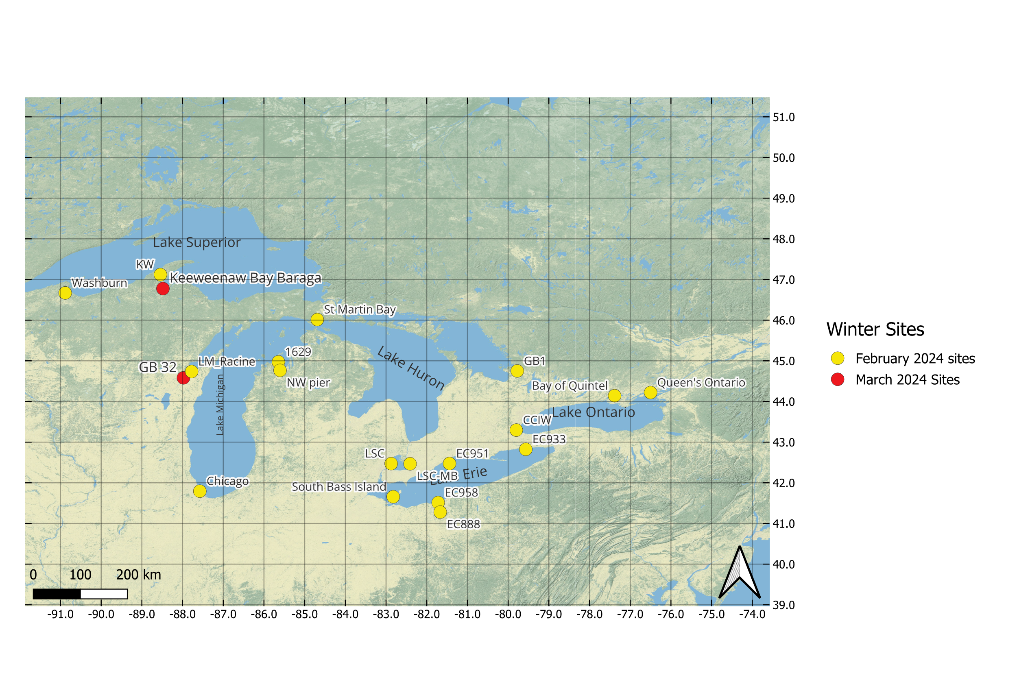
2024 Winter Grab Winter Season Sampling Sites
20 sites total
3 sites in Lake Superior.
5 Sites in Lake Michigan.
2 sites in Lake Huron
7 sites in Lake Erie
3 sties in Lake Ontario

Slide 3
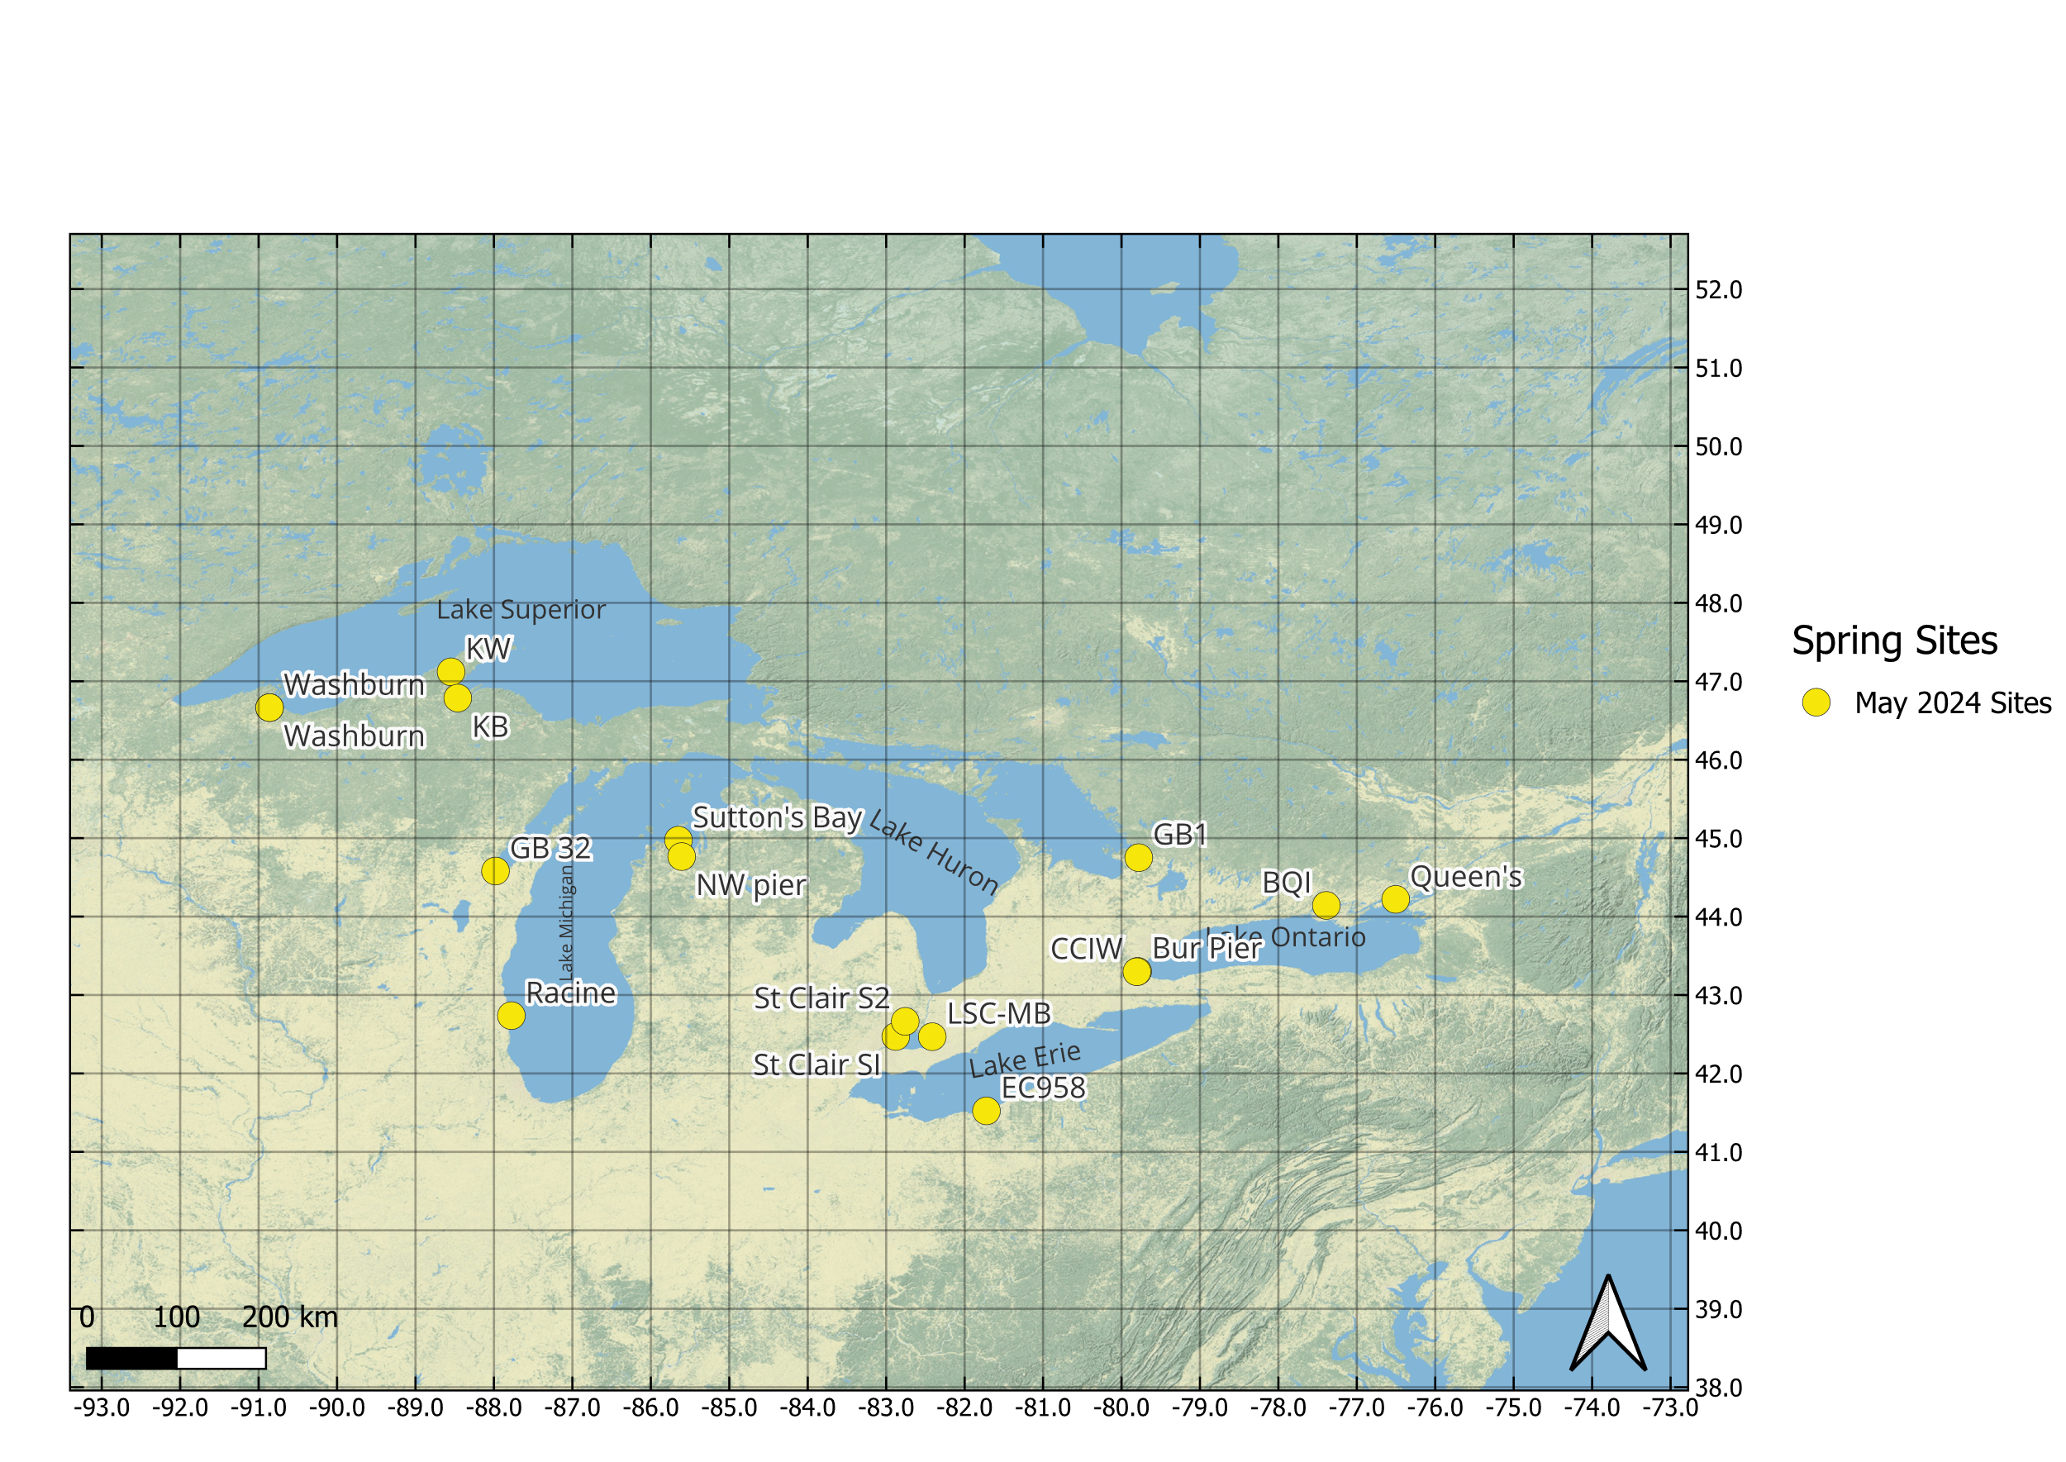
2024 Winter Grab Spring Season Sampling Sites
15 sites total
3 sites in Lake Superior.
4 sites in Lake Michigan.
1 site in Lake Huron
4 sites in Lake Erie
3 sties in Lake Ontario

Slide 4
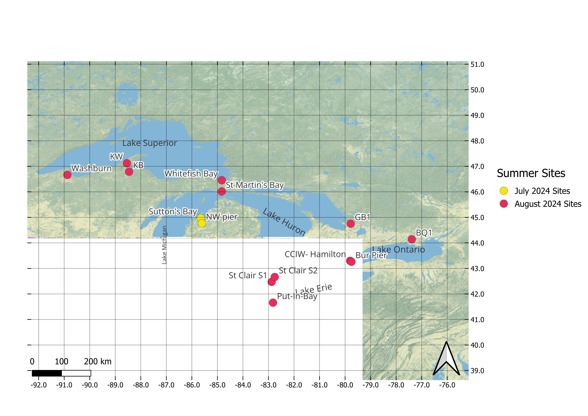
2024 Winter Grab Summer Season Sampling Sites
16 sites total
4 sites in Lake Superior.
4 sites in Lake Michigan.
2 sites in Lake Huron
7 sites in Lake Erie
3 sties in Lake Ontario
Notes:
Need the coordinates for GB 32 and Racine (Michigan)
SCS2 is having some issue with showing up correctly in QGIS

Slide 5
DOC concentration for each site by sampling season
Spring and Summer appear to have higher DOC concentrations
There are a few outliers with exceptionally high DOC in respect to other sites and within sampling seasons

Slide 6
TDN concentration for each site by sampling season
TDN concentrations look like they remain stable between sampling seasons
There are once again a few outliers with high TDN concentration
Summer and Spring concentrations appear to be slightly larger

Slide 7
DOC and TDN Concentrations for each Sampling Season
Dotted line is equal to Redfield’s ratio of C:N
Summer sites appear to be on or above Redfield’s ratio
Winter may be clustering at or just below Redfield’s ratio and in smaller concentrations

Slide 8
Leucine and Thymidine uptake for each Sampling Season (Bacterial Production)
Spring sampling appears to be clustered
On average, the summer season has a lower Leu:TdR than the winter season
The cluster of winter sites in the bottom could be misleading
We do not have spring or summer data for a few sites.

Slide 9
Future Data and Ongoing Analyses
Analytes that need to be measured (Vick-Majors lab)
16s rRNA (DNA)
Bacterial cell counts (Flow cytometry)
EEMs (Have been analyzed but has not been processed)
Samples for other analytes have been shipped out
Please contact me and/or Tristy with any questions
Data from Data sheets (Still need to be formatted for data template)
LiCor measurements
CTD profiles

Slide 10

Thank you

